Slide 1
Chapter 16 Ajax
簡廷因 Ting-Ying Chien
2015.12.28

Slide 2
Outline
Introduction
“Raw” Ajax Example Using the XMLhttpRequest Object
jQuery Ajax

Slide 3
Introduction
Ajax applications separate client-side user interaction and server communication, and run them in parallel, making the delays of server-side processing more transparent to the user
“Raw” Ajax uses JavaScript to send asynchronous requests to the server, then updates the page using the DOM
When writing “raw” Ajax you need to deal directly with cross-browser portability issues, making it impractical for developing large-scale applications

Slide 4
Introduction
Client-side of Ajax applications
Written in HTML5 and CSS3
Uses JavaScript to add functionality to the user interface
XML and JSON are used to structure the data passed between the server and the client
XMLHttpRequest
The Ajax component that manages interaction with the server

Slide 5
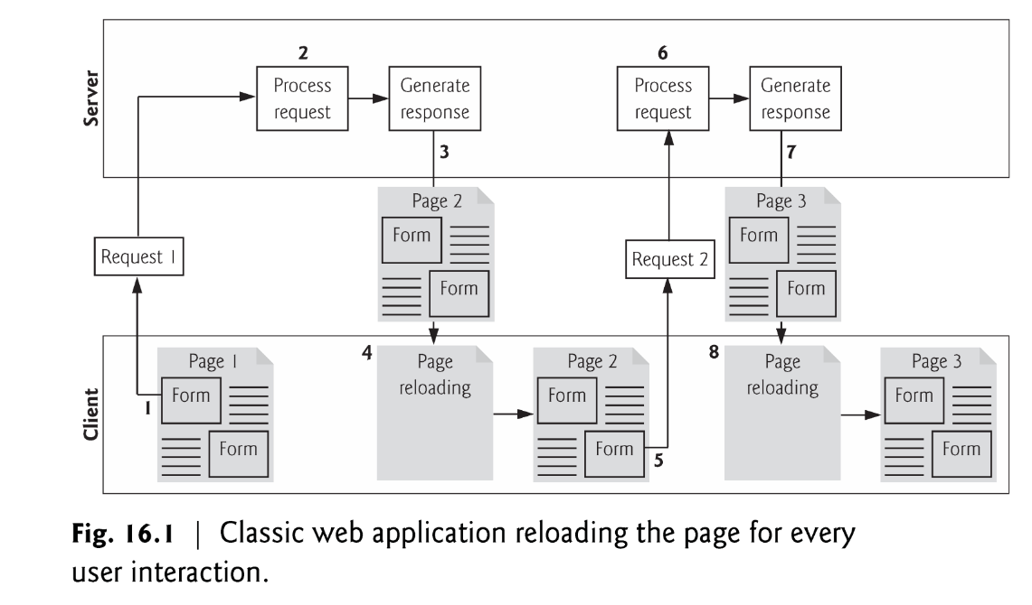
Introduction
Traditional web applications
While a synchronous request is being processed on the server, the user cannot interact with the client web browser
Client waits for the server to respond and reloads the entire page with the data from the response

Slide 6
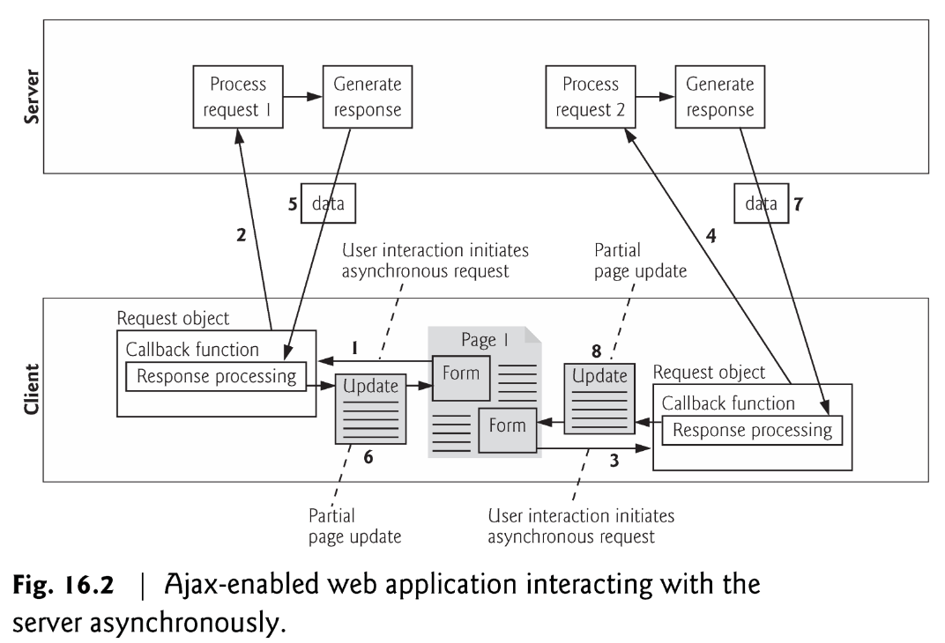
Introduction
Ajax Web Applications
Callback function updates only a designated part of the page
Partial page updates help make web applications more responsive, making them feel more like desktop applications

Slide 7
“Raw” Ajax Example Using the XMLhttpRequest Object
<!DOCTYPE html>
<html>
<head>
<meta charset = "utf-8">
<style type = "text/css">
.box { border: 1px solid black; padding: 10px }
</style>
<title>Switch Content Asynchronously</title>
<script>
var asyncRequest; // variable to hold XMLHttpRequest object
function registerListeners()
{
var img;
img = document.getElementById( "cpphtp" );
img.addEventListener( "mouseover", function() { getContent( "cpphtp.html" ); }, false );
img.addEventListener( "mouseout", clearContent, false );
img = document.getElementById( "iw3htp" );
img.addEventListener( "mouseover", function() { getContent( "iw3htp.html" ); }, false );
img.addEventListener( "mouseout", clearContent, false );
img = document.getElementById( "jhtp" );
img.addEventListener( "mouseover", function() { getContent( "jhtp.html" ); }, false );
img.addEventListener( "mouseout", clearContent, false );
img = document.getElementById( "vbhtp" );
img.addEventListener( "mouseover", function() { getContent( "vbhtp.html" ); }, false );
img.addEventListener( "mouseout", clearContent, false );
img = document.getElementById( "vcshtp" );
img.addEventListener( "mouseover", function() { getContent( "vcshtp.html" ); }, false );
img.addEventListener( "mouseout", clearContent, false );
img = document.getElementById( "javafp" );
img.addEventListener( "mouseover", function() { getContent( "javafp.html" ); }, false );
img.addEventListener( "mouseout", clearContent, false );
}
http://140.138.77.210/course/ch16.zip

Slide 8
“Raw” Ajax Example Using the XMLhttpRequest Object
function getContent( url )
{
try
{
asyncRequest = new XMLHttpRequest(); // create request object
// register event handler
asyncRequest.addEventListener("readystatechange", stateChange, false);
asyncRequest.open( "GET", url, true ); // prepare the request
asyncRequest.send( null ); // send the request
}
catch ( exception )
{
alert( "Request failed." );
}
}
function stateChange()
{
if ( asyncRequest.readyState == 4 && asyncRequest.status == 200 )
{
document.getElementById( "contentArea" ).innerHTML =
asyncRequest.responseText;
}
}
function clearContent()
{
document.getElementById( "contentArea" ).innerHTML = "";
}
window.addEventListener( "load", registerListeners, false );
</script>
</head>

Slide 9
“Raw” Ajax Example Using the XMLhttpRequest Object
<body>
<h1>Mouse over a book for more information.</h1>
<img id = "cpphtp" alt = "C++ How to Program book cover"
src = "http://test.deitel.com/images/thumbs/cpphtp8.jpg">
<img id = "iw3htp" alt = "Internet & WWW How to Program book cover"
src = "http://test.deitel.com/images/thumbs/iw3htp5.jpg">
<img id = "jhtp" alt = "Java How to Program book cover"
src = "http://test.deitel.com/images/thumbs/jhtp9.jpg">
<img id = "vbhtp" alt = "Visual Basic 2010 How to Program book cover"
src = "http://test.deitel.com/images/thumbs/vb2010htp.jpg">
<img id = "vcshtp" alt = "Visual C# 2010 How to Program book cover"
src = "http://test.deitel.com/images/thumbs/vcsharp2010htp.jpg">
<img id = "javafp" alt = "Java for Programmers book cover"
src = "http://test.deitel.com/images/thumbs/javafp.jpg">
<div class = "box" id = "contentArea"></div>
</body>
</html>

Slide 10
“Raw” Ajax Example Using the XMLhttpRequest Object
XMLHttpRequest object
Resides on the client
Is the layer between the client and the server that manages asynchronous requests in Ajax applications
Supported on most browsers, though they may implement it differently
To initiate an asynchronous request
Create an instance of the XMLHttpRequest object
Use its open method to set up the request, and its send method to initiate the request
When an Ajax application requests a file from a server, the browser typically caches that file
Subsequent requests for the same file can load it from the browser’s cache
When the third argument to XMLHttpRequest method open is true, the request is asynchronous

Slide 11
“Raw” Ajax Example Using the XMLhttpRequest Object
XMLHttpRequest object
open function
Specifies the type of request
Parameter
method: the type of request: GET or POST
url: the server (file) location
async: true (asynchronous) or false (synchronous)
send function
Sends the request to the server
Example :
xhttp.open("GET", "demo_get2.php?fname=Henry&lname=Ford", true);
xhttp.send();
xhttp.open("POST", "ajax_test.php", true);
xhttp.send("fname=Henry&lname=Ford");
Ref: http://www.w3schools.com/ajax/ajax_xmlhttprequest_send.asp

Slide 12
“Raw” Ajax Example Using the XMLhttpRequest Object
XMLHttpRequest object
readyState
Holds the status of the XMLHttpRequest. Changes from 0 to 4
0: request not initialized
1: server connection established
2: request received
3: processing request
4: request finished and response is ready
Status
HTTP status code
200: "OK" 404: Page not found
Ref: http://www.w3schools.com/ajax/ajax_xmlhttprequest_onreadystatechange.asp

Slide 13
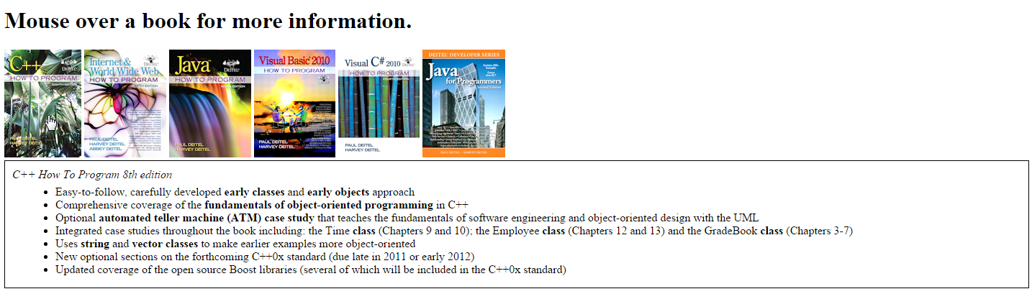
“Raw” Ajax Example Using the XMLhttpRequest Object

Slide 14
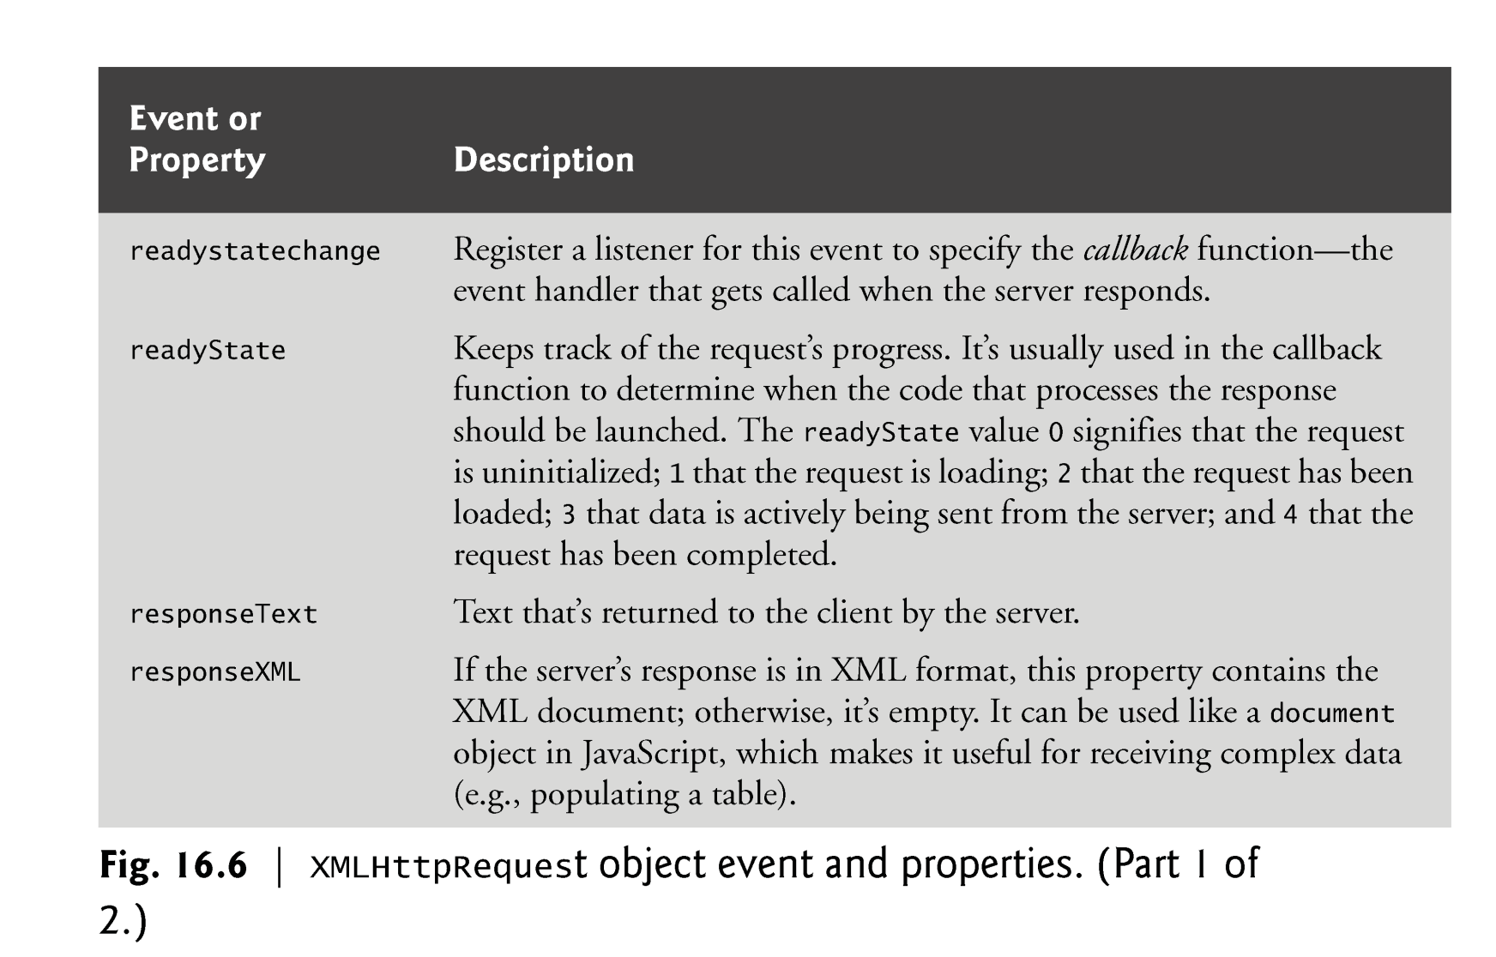
XMLHttpRequest object

Slide 15
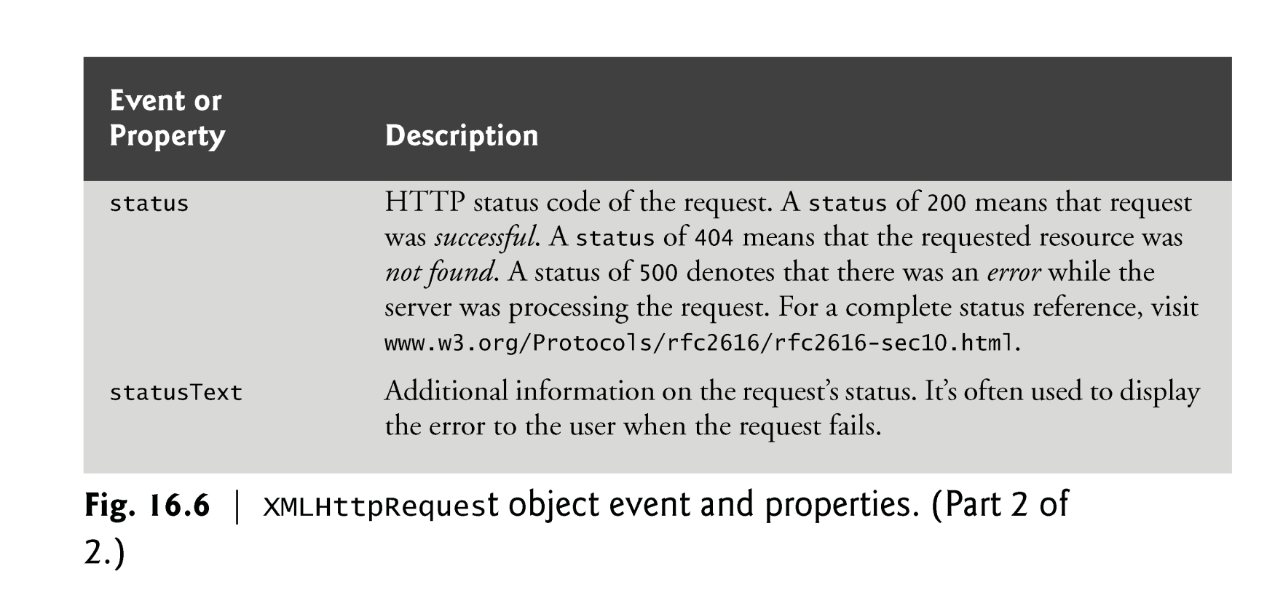
XMLHttpRequest object

Slide 16
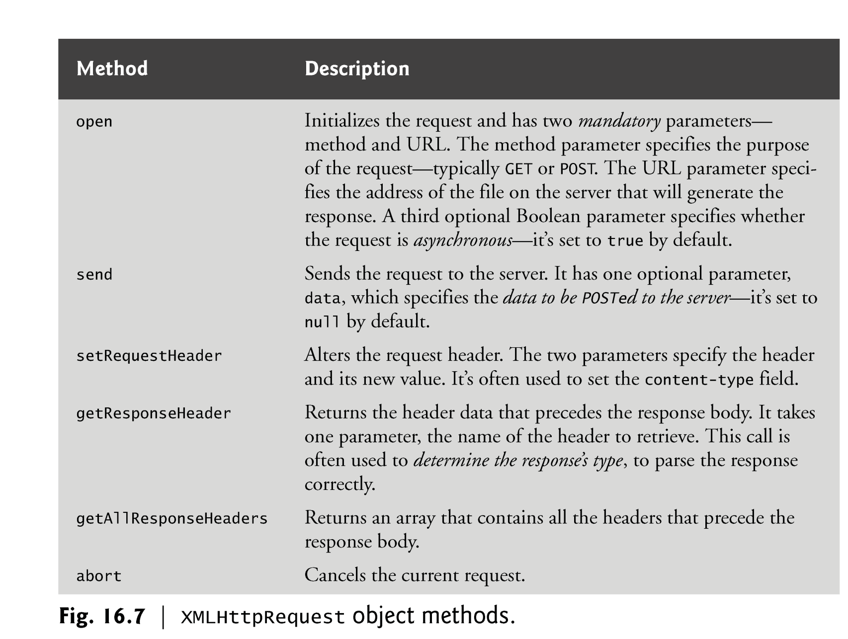
XMLHttpRequest object

Slide 17
jQuery Ajax

Slide 18
Introduction
jQuery is a fast, small, and feature-rich JavaScript library. It makes things like HTML document traversal and manipulation, event handling, animation, and Ajax much simpler with an easy-to-use API that works across a multitude of browsers.

Slide 19

jQuery Ajax + PHP
<!DOCTYPE html>
<html>
<head>
<meta charset = "utf-8">
<title>jQuery Ajax and PHP</title>
<script src="//code.jquery.com/jquery-2.1.4.min.js"></script>
<script>
function start()
{
var id = window.prompt( "Please enter your ID" );
$.ajax({
url: "test.php",
data: {
name: id
},
type: "POST",
datatype: "html",
success: function( output ) {
document.getElementById( "out" ).innerHTML = output;
},
error : function(){
alert( "Request failed." );
}
});
}
window.addEventListener( "load", start, false );
</script>
</head>
<body>
<div id="out"></div>
</body>
</html>
url:將資料傳到哪個位置
data:傳送的變數
type:傳送的方式 (GET/POST)
dataType:資料回傳的格式(html/script/json/xml)
success: 抓取資料成功後做的事
error: 抓取資料失敗後做的事
<?php
$name = $_POST["name"];
print ("<p>Hello, $name</p>");
?>
test.php

Slide 20
jQuery Ajax + PHP
<!DOCTYPE html>
<html>
<head>
<meta charset = "utf-8">
<title>jQuery Ajax and PHP</title>
<script src="//code.jquery.com/jquery-2.1.4.min.js"></script>
<script>
$(function(){
var id = window.prompt( "Please enter your ID" );
$.ajax({
url: "test.php",
data: {
name: id
},
type: "POST",
datatype: "html",
success: function( output ) {
$( "#out" ).html(output);
},
error : function(){
alert( "Request failed." );
}
});
});
</script>
</head>
<body>
<div id="out"></div>
</body>
</html>
<?php
$name = $_POST["name"];
print ("<p>Hello, $name</p>");
?>
test.php

Slide 21

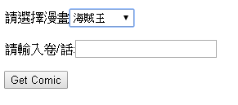
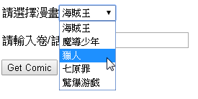
Exercise
Get comic automatically
jQuery Ajax + PHP
var cid = $("#cid").val();
var vol = $("#vol").val();
function urlexist ($url)
{
$headers = @get_headers($url);
if(strpos($headers[0],'404') === false)
{ return true;}
else { return false;}
}

Slide 22
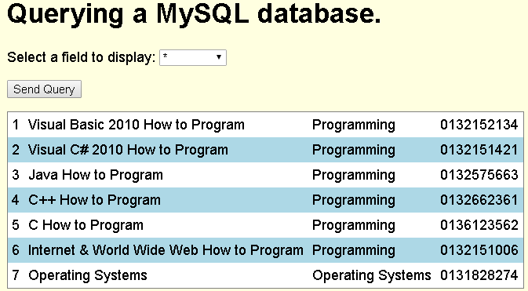
jQuery Ajax + PHP + MySQL
<!DOCTYPE html>
<html>
<head>
<meta charset = "utf-8">
<title>Sample Database Query</title>
<script src="//code.jquery.com/jquery-2.1.4.min.js"></script>
<script>
function progress() {
var sel = $("#select").val();
$.ajax({
url: "database.php",
data: {
select: sel
},
type: "POST",
datatype: "html",
success: function( output ) {
$( "#out" ).html(output);
},
error : function(){
alert( "Request failed." );
}
});
}
</script>
<style type = "text/css">
body { font-family: sans-serif;
background-color: lightyellow; }
table { background-color: lightblue;
border-collapse: collapse;
border: 1px solid gray; }
td { padding: 5px; }
tr:nth-child(odd) { background-color: white; }
</style>
</head>

Slide 23
jQuery Ajax + PHP + MySQL
<body>
<h1>Querying a MySQL database.</h1>
<form method = "post" action = "#">
<p>Select a field to display:
<select id = "select">
<option selected>*</option>
<option>ID</option>
<option>Title</option>
<option>Category</option>
<option>ISBN</option>
</select></p>
<p><input id = "submit" type="button" value = "Send Query" onclick="progress()"></p>
</form>
<div id="out"></div>
</body>
</html>

Slide 24
jQuery Ajax + PHP + MySQL
database.php
<?php
$select = $_POST["select"];
$query = "SELECT " . $select . " FROM books";
if ( !( $database = mysql_connect( "localhost", "USERID", "password" ) ) )
die( "Could not connect to database </body></html>" );
if ( !mysql_select_db( "products", $database ) )
die( "Could not open products database </body></html>" );
if ( !( $result = mysql_query( $query, $database ) ) )
{
print( "<p>Could not execute query!</p>" );
die( mysql_error() . "</body></html>" );
}
mysql_close( $database );
print ("<table>");
while ( $row = mysql_fetch_row( $result ) )
{
print( "<tr>" );
foreach ( $row as $value )
print( "<td>$value</td>" );
print( "</tr>" );
}
print ("</table>");
?>

Slide 25
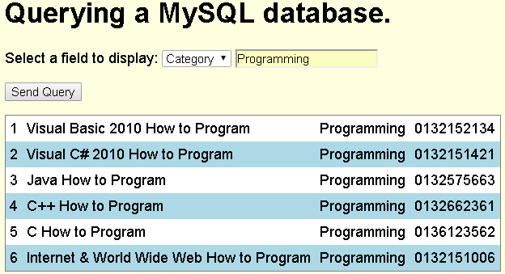
Exercise
Ref : ch19.v1.pptx p37

Slide 26
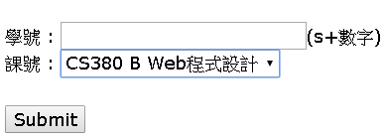
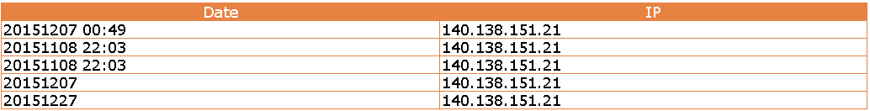
Exercise
簽到系統
Hint :
$today = date("Ymd");
$ip=$_SERVER['REMOTE_ADDR']

Slide 27
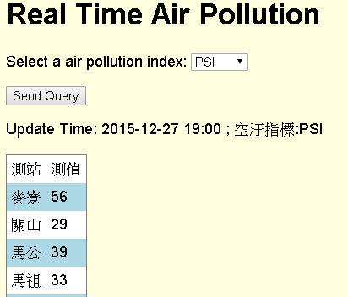
jQuery Ajax + PHP + CSV
<!DOCTYPE html>
<html>
<head>
<meta charset = "utf-8">
<title>Sample CSV Query</title>
<script src="//code.jquery.com/jquery-2.1.4.min.js"></script>
<script>
function progress() {
var aq = $("#aqindex").val();
$.ajax({
url: "csv.php",
data: {
aq: aq
},
type: "POST",
datatype: "html",
success: function( output ) {
$( "#out" ).html(output);
},
error : function(){
alert( "Request failed." );
}
});
}
</script>
<style type = "text/css">
body { font-family: sans-serif;
background-color: lightyellow; }
table { background-color: lightblue;
border-collapse: collapse;
border: 1px solid gray; }
td { padding: 5px; }
tr:nth-child(odd) { background-color: white; }
</style>
</head>

Slide 28
jQuery Ajax + PHP + CSV
<body>
<h1>Real Time Air Pollution</h1>
<form method = "post" action = "#">
<p>Select a air pollution index:
<select id = "aqindex">
<option selected>PSI</option>
<option>SO2</option>
<option>CO</option>
<option>O3</option>
<option>PM10</option>
<option>PM2.5</option>
<option>NO2</option>
</select></p>
<p><input id = "submit" type="button" value = "Send Query" onclick="progress()"></p>
</form>
<div id="out"></div>
</body>
</html>

Slide 29
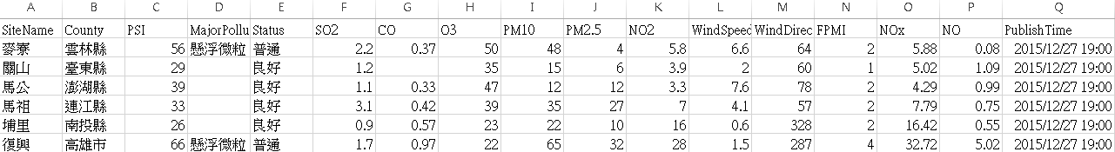
jQuery Ajax + PHP + CSV
<?php
$aq = $_POST["aq"];
$data = file_get_contents("http://opendata.epa.gov.tw/ws/Data/AQX/?format=csv");
$rows = explode("\n",$data);
$s = array();
$num=0;
foreach($rows as $row) {
$s[] = str_getcsv($row);
$num++;
}
$time = $s[1][16];
print ("<p>Update Time: $time ; 空汙指標:$aq</p>");
$index =0;
switch ($aq)
{
case "PSI":$index=2;break;
case "SO2":$index=5;break;
case "CO":$index=6;break;
case "O3":$index=7;break;
case "PM10":$index=8;break;
case "PM2.5":$index=9;break;
case "NO2":$index=10;break;
}
print ("<table><tr><td>測站</td><td>測值</td></tr>");
for ($i=1;$i<$num-1;$i++)
{
$station = $s[$i][0];
$value = $s[$i][$index];
print ("<tr><td>$station</td><td>$value</td></tr>");
}
print ("</table>");
?>

Slide 30
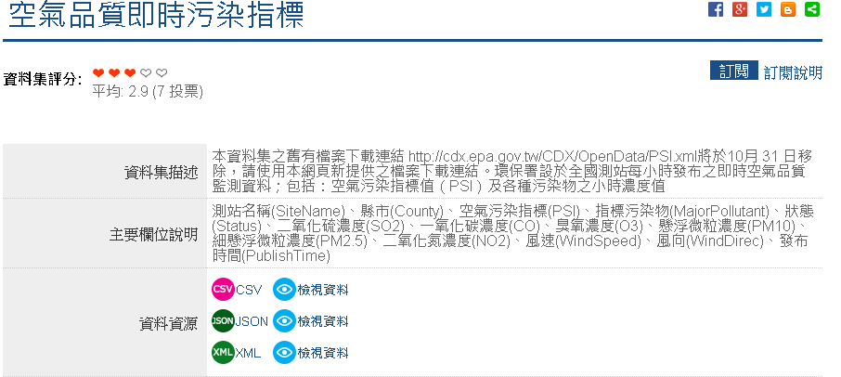
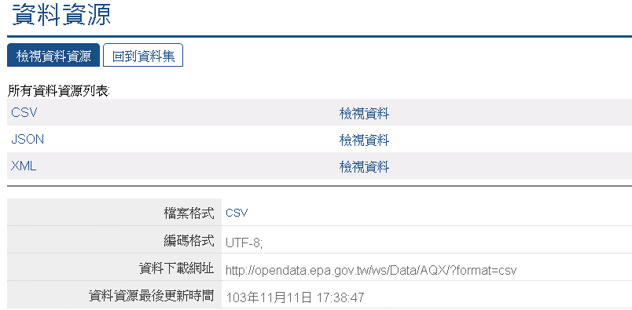
jQuery Ajax + PHP + CSV
Open Data
http://data.gov.tw/node/6074

Slide 31
Exercise
依使用者選擇, 列出該縣市測速執法設置點
Data:
http://data.gov.tw/node/7320

Slide 32
XML

Slide 33
Introduction
XML stands for EXtensible Markup Language
XML is a markup language much like HTML
XML was designed to store and transport data
Ajax applications often use XML because it consumes little bandwidth and is easy to parse

Slide 34
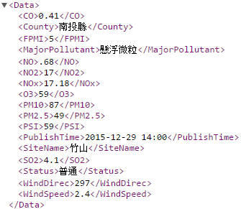
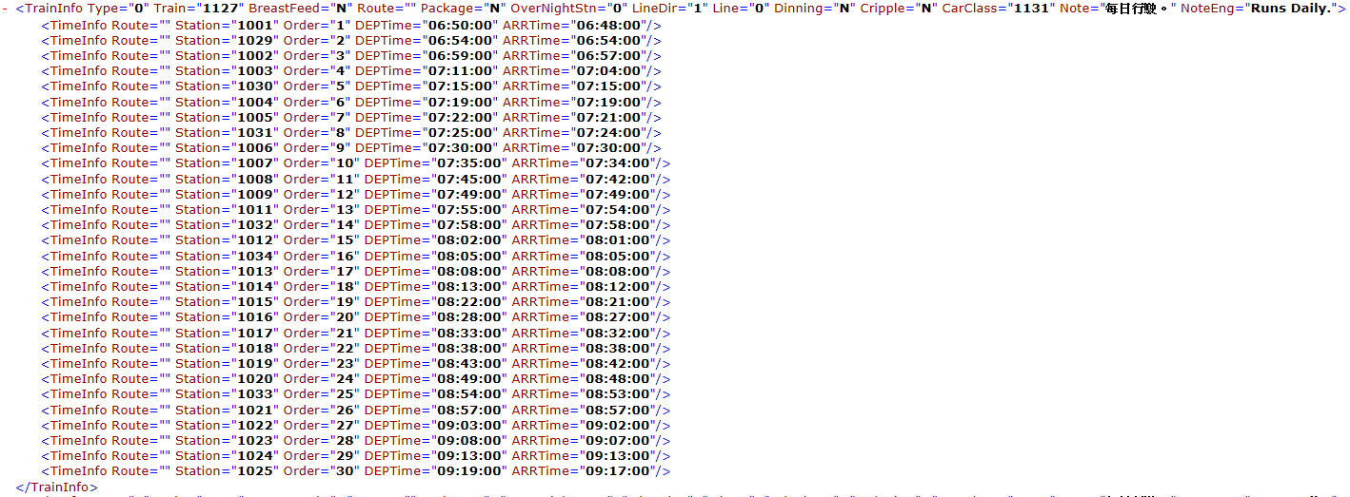
Introduction
start tag
Tag
Element
Attribute
end tag
empty-element tag

Slide 35
XML
<!DOCTYPE html>
<html>
<head>
<meta charset="utf-8">
<title> Pulling Images onto the Page </title>
<style type = "text/css">
li { display: inline-block; padding: 4px; width: 120px; }
img { border: 1px solid black }
</style>
<script>
var asyncRequest;
function getImages( url )
{
try
{
asyncRequest = new XMLHttpRequest();
asyncRequest.addEventListener("readystatechange", processResponse, false);
asyncRequest.open( "GET", url, true );
asyncRequest.send( null );
}
catch ( exception )
{
alert( "Request Failed" );
}
}

Slide 36
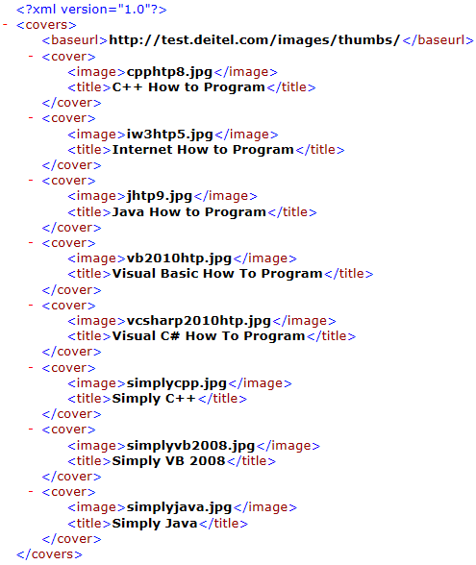
XML
item(0)
item(1)
item(2)
item(3)
function processResponse()
{
if ( asyncRequest.readyState == 4 && asyncRequest.status == 200 && asyncRequest.responseXML )
{
clearImages();
var covers = asyncRequest.responseXML.getElementsByTagName("cover");
var baseUrl = asyncRequest.responseXML.getElementsByTagName("baseurl").item( 0 ).firstChild.nodeValue;
var output = document.getElementById( "covers" );
var imagesUL = document.createElement( "ul" );
for ( var i = 0; i < covers.length; ++i )
{
var cover = covers.item( i );
var image = cover.getElementsByTagName( "image" ).item( 0 ).firstChild.nodeValue;
var imageLI = document.createElement( "li" );
var imageTag = document.createElement( "img" );
imageTag.setAttribute( "src", baseUrl + escape( image ) );
imageLI.appendChild( imageTag );
imagesUL.appendChild( imageLI );
}
output.appendChild( imagesUL );
}
}

Slide 37
XML
function clearImages()
{
document.getElementById( "covers" ).innerHTML = "";
}
function registerListeners()
{
document.getElementById( "all" ).addEventListener("click",
function() { getImages( "all.xml" ); }, false );
document.getElementById( "simply" ).addEventListener("click",
function() { getImages( "simply.xml" ); }, false );
document.getElementById( "howto" ).addEventListener("click",
function() { getImages( "howto.xml" ); }, false );
document.getElementById( "dotnet" ).addEventListener("click",
function() { getImages( "dotnet.xml" ); }, false );
document.getElementById( "javaccpp" ).addEventListener("click",
function() { getImages( "javaccpp.xml" ); }, false );
document.getElementById( "none" ).addEventListener("click", clearImages, false );
}
window.addEventListener( "load", registerListeners, false );
</script>
</head>

Slide 38
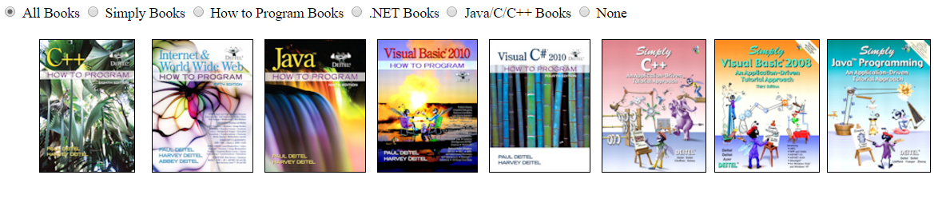
XML
<body>
<input type = "radio" name ="Books" value = "all" id = "all"> All Books
<input type = "radio" name = "Books" value = "simply" id = "simply"> Simply Books
<input type = "radio" name = "Books" value = "howto" id = "howto"> How to Program Books
<input type = "radio" name = "Books" value = "dotnet" id = "dotnet"> .NET Books
<input type = "radio" name = "Books" value = "javaccpp" id = "javaccpp"> Java/C/C++ Books
<input type = "radio" checked name = "Books" value = "none" id = "none"> None
<div id = "covers"></div>
</body>
</html>

Slide 39
XML
Ref: http://www.w3schools.com/xml/dom_element.asp
firstChild Property
returns the first child node of the selected element
childNodes Property
Returns a NodeList of child nodes for the element
var covers = asyncRequest.responseXML.getElementsByTagName("cover");
for ( var i = 0; i < covers.length; ++i )
{
var cover = covers.item( i );
var image = cover.getElementsByTagName( "image" ).item( 0 ).firstChild.nodeValue;
}
clildNodes[0]
covers.item(0)
covers.item(1)
covers.item(2)

Slide 40
jQuery Ajax + XML
<!DOCTYPE html>
<html>
<head>
<meta charset="utf-8">
<title> Pulling Images onto the Page </title>
<script src="//code.jquery.com/jquery-2.1.4.min.js"></script>
<style type = "text/css">
li { display: inline-block; padding: 4px; width: 120px; }
img { border: 1px solid black }
</style>
<script>
function getImages( url )
{
$.ajax({
url: url,
type: "GET",
datatype: "xml",
success: function( xml ) {
clearImages();
var output = document.getElementById( "covers" );
var imagesUL = document.createElement( "ul" );
var baseUrl = $(xml).find("baseurl").text();
$(xml).find("cover").each(function(){
var image = $(this).children('image').text();
var imageLI = document.createElement( "li" );
var imageTag = document.createElement( "img" );
imageTag.setAttribute( "src", baseUrl + escape( image ) );
imageLI.appendChild( imageTag );
imagesUL.appendChild( imageLI );
});
output.appendChild( imagesUL );
},
error : function(){
alert( "Request failed." );
}
});
}

Slide 41
jQuery Ajax + XML
function clearImages()
{
document.getElementById( "covers" ).innerHTML = "";
}
function registerListeners()
{
document.getElementById( "all" ).addEventListener("click",
function() { getImages( "all.xml" ); }, false );
document.getElementById( "simply" ).addEventListener("click",
function() { getImages( "simply.xml" ); }, false );
document.getElementById( "howto" ).addEventListener("click",
function() { getImages( "howto.xml" ); }, false );
document.getElementById( "dotnet" ).addEventListener("click",
function() { getImages( "dotnet.xml" ); }, false );
document.getElementById( "javaccpp" ).addEventListener("click",
function() { getImages( "javaccpp.xml" ); }, false );
document.getElementById( "none" ).addEventListener("click", clearImages, false );
}
window.addEventListener( "load", registerListeners, false );
</script>
</head>

Slide 42
jQuery Ajax + XML
<body>
<input type = "radio" name ="Books" value = "all" id = "all"> All Books
<input type = "radio" name = "Books" value = "simply" id = "simply"> Simply Books
<input type = "radio" name = "Books" value = "howto" id = "howto"> How to Program Books
<input type = "radio" name = "Books" value = "dotnet" id = "dotnet"> .NET Books
<input type = "radio" name = "Books" value = "javaccpp" id = "javaccpp"> Java/C/C++ Books
<input type = "radio" checked name = "Books" value = "none" id = "none"> None
<div id = "covers"></div>
</body>
</html>

Slide 43
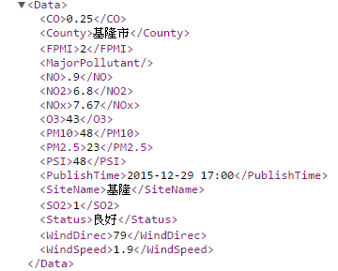
jQuery Ajax + XML
<!DOCTYPE html>
<html>
<head>
<meta charset = "utf-8">
<title>Sample CSV Query</title>
<script src="//code.jquery.com/jquery-2.1.4.min.js"></script>
<script>
function progress() {
var aq = $("#aqindex").val();
$.ajax({
url: "AQX.xml",
type: "GET",
datatype: "xml",
success: function( xml ) {
var output = document.getElementById( "out" );
$(xml).find("Data").each(function(){
var row = document.createElement( "tr" );
var station = document.createTextNode($(this).children("SiteName").text());
var value = document.createTextNode($(this).children(aq).text());
var c1 = document.createElement( "td");
c1.appendChild(station);
row.appendChild( c1);
var c2 = document.createElement( "td");
c2.appendChild(value);
row.appendChild( c2);
output.appendChild( row );
});
},
error : function(){
alert( "Request failed." );
}
});
}
</script>

Slide 44
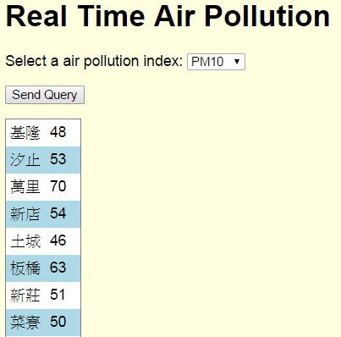
jQuery Ajax + XML
<style type = "text/css">
body { font-family: sans-serif;
background-color: lightyellow; }
table { background-color: lightblue;
border-collapse: collapse;
border: 1px solid gray; }
td { padding: 5px; }
tr:nth-child(odd) { background-color: white; }
</style>
</head>
<body>
<h1>Real Time Air Pollution</h1>
<form method = "post" action = "#">
<p>Select a air pollution index:
<select id = "aqindex">
<option selected>PSI</option>
<option>SO2</option>
<option>CO</option>
<option>O3</option>
<option>PM10</option>
<option>PM2.5</option>
<option>NO2</option>
</select></p>
<p><input id = "submit" type="button" value = "Send Query" onclick="progress()"></p>
</form>
<table id="out"></table>
</body>
</html>

Slide 45
Cross-origin resource sharing (CORS)
No 'Access-Control-Allow-Origin' header is present on the requested resource. ERROR
Same-origin policy
a security measure implemented in browsers to restrict interaction between documents (or scripts) that have different origins
Solution
Cross-origin resource sharing (CORS)
url: "AQX.xml"
change to
url: "http://opendata2.epa.gov.tw/AQX.xml"

Slide 46
Cross-origin resource sharing (CORS)
Method 1 :
Apache
Header set Access-Control-Allow-Origin "*"
Method 2 :
php
header("Access-Control-Allow-Origin: *");
ref : http://enable-cors.org/server.html

Slide 47
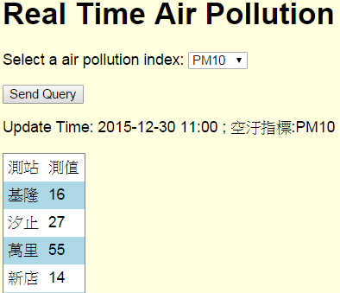
jQuery Ajax + PHP + XML
<!DOCTYPE html>
<html>
<head>
<meta charset = "utf-8">
<title>Sample XML Query</title>
<script src="//code.jquery.com/jquery-2.1.4.min.js"></script>
<script>
function progress() {
var aq = $("#aqindex").val();
$.ajax({
url: "xml.php",
data: {
aq: aq
},
type: "POST",
datatype: "html",
success: function( output ) {
$( "#out" ).html(output);
},
error : function(){
alert( "Request failed." );
}
});
}
</script>
<style type = "text/css">
body { font-family: sans-serif;
background-color: lightyellow; }
table { background-color: lightblue;
border-collapse: collapse;
border: 1px solid gray; }
td { padding: 5px; }
tr:nth-child(odd) { background-color: white; }
</style>
</head>

Slide 48
jQuery Ajax + PHP + XML
<body>
<h1>Real Time Air Pollution</h1>
<form method = "post" action = "#">
<p>Select a air pollution index:
<select id = "aqindex">
<option selected>PSI</option>
<option>SO2</option>
<option>CO</option>
<option>O3</option>
<option>PM10</option>
<option>PM2.5</option>
<option>NO2</option>
</select></p>
<p><input id = "submit" type="button" value = "Send Query" onclick="progress()"></p>
</form>
<div id="out"></div>
</body>
</html>

Slide 49
jQuery Ajax + PHP + XML
<?php
$aq = $_POST["aq"];
header("Access-Control-Allow-Origin: *");
$context = stream_context_create(array('http' => array('header' => 'Accept: application/xml')));
$url = "http://opendata.epa.gov.tw/ws/Data/AQX/?format=xml" ;
$xml = file_get_contents($url, false, $context);
$xml = simplexml_load_string($xml);
$time = $xml->Data->PublishTime;
print ("<p>Update Time: $time ; 空汙指標:$aq</p>");
print ("<table><tr><td>測站</td><td>測值</td></tr>");
foreach ($xml->Data as $key)
{
$station = $key->SiteName;
$value = $key->{$aq};
print ("<tr><td>$station</td><td>$value</td></tr>");
}
print ("</table>");
?>

Slide 50
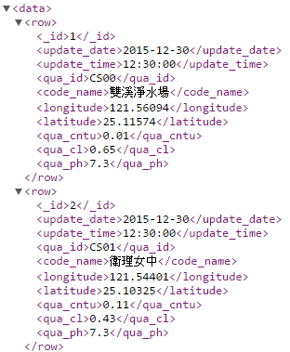
Exercise
臺北市水質監測資訊
http://data.taipei/opendata/datalist/apiAccess?scope=resourceAquire&rid=190796c8-7c56-42e0-8068-39242b8ec927&format=xml
欄位說明
1.update_date : 日期
2.update_time : 時間
3.qua_id : 監控站ID
4.code_name : 監控站名稱
5.longitude : 經度
6.latitude: 緯度
7.qua_cntu: 濁度(NTU)
8.qua_cl: 餘氯(mg/L)
9.qua_ph: 酸度(pH)
10.偵測值-9係維修中，暫停偵測。

Slide 51
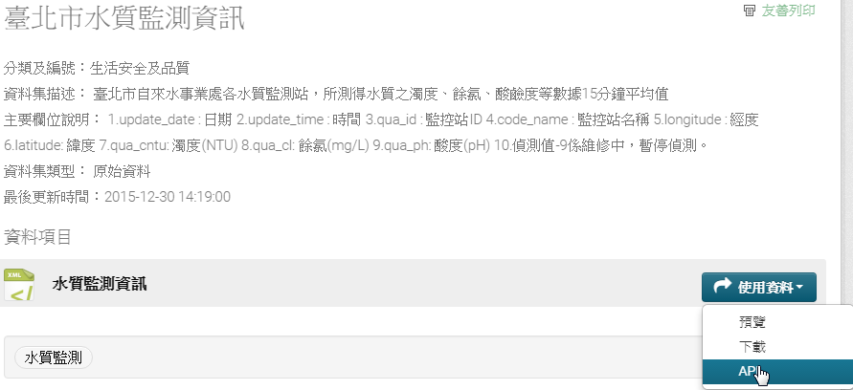
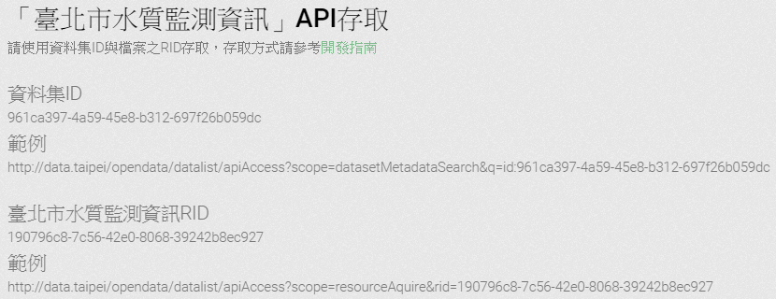
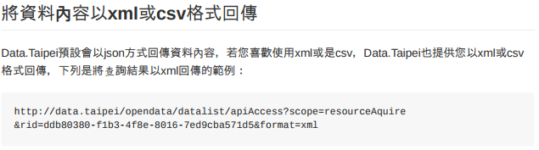
Taipei Open Data
http://data.taipei/opendata/datalist/apiAccess?scope=resourceAquire&rid=190796c8-7c56-42e0-8068-39242b8ec927&format=xml

Slide 52
JSON

Slide 53
Introduction
JSON (JavaScript Object Notation)
Simple way to represent JavaScript objects as strings
A simpler alternative to XML for passing data between the client and the server
JSON object
Represented as a list of property names and values contained in curly braces
Array
Represented in JSON with square brackets containing a comma-separated list of values
Each value in a JSON array can be a string, a number, a JSON representation of an object, true, false or null
JSON strings
Easier to create and parse than XML
Require fewer bytes
For these reasons, JSON is commonly used to communicate in client/server interaction

Slide 54
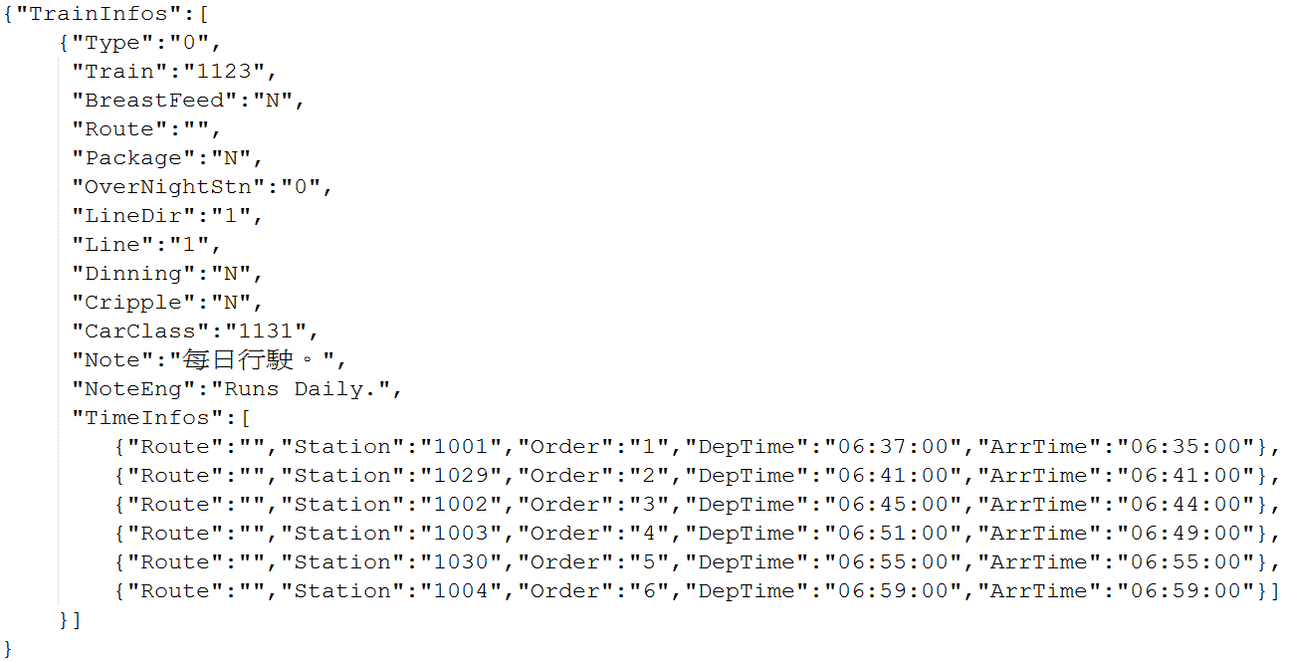
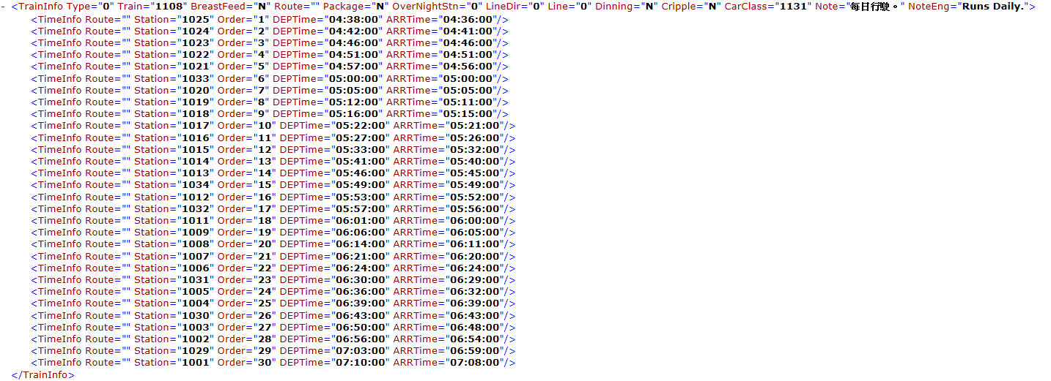
Introduction
JSON v.s XML

Slide 55
JSON
<!DOCTYPE html>
<html>
<head>
<meta charset = "utf-8">
<title>Sample JSON Query</title>
<script>
var asyncRequest;
function progress()
{
try
{
asyncRequest = new XMLHttpRequest();
asyncRequest.addEventListener("readystatechange", processResponse, false);
asyncRequest.open( "GET", "AQX.json", true );
asyncRequest.send( null );
}
catch ( exception )
{
alert( "Request Failed" );
}
}

Slide 56
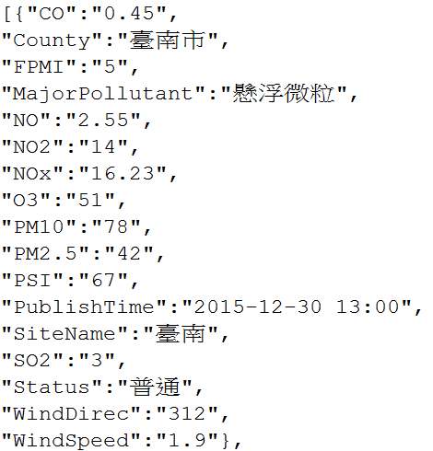
JSON
function processResponse()
{
if ( asyncRequest.readyState == 4 && asyncRequest.status == 200 )
{
var output = document.getElementById( "out" );
var data = JSON.parse(asyncRequest.responseText);
var aq = document.getElementById( "aqindex" ).value;
for (var i = 0;i<data.length;i++)
{
var row = document.createElement( "tr" );
var station = document.createTextNode(data[i]["SiteName"]);
var value = document.createTextNode(data[i][aq]);
var c1 = document.createElement( "td");
c1.appendChild(station);
row.appendChild( c1);
var c2 = document.createElement( "td");
c2.appendChild(value);
row.appendChild( c2);
output.appendChild( row );
}
}
}
</script>

Slide 57
JSON
<style type = "text/css">
body { font-family: sans-serif;
background-color: lightyellow; }
table { background-color: lightblue;
border-collapse: collapse;
border: 1px solid gray; }
td { padding: 5px; }
tr:nth-child(odd) { background-color: white; }
</style>
</head>
<body>
<h1>Real Time Air Pollution</h1>
<form method = "post" action = "#">
<p>Select a air pollution index:
<select id = "aqindex">
<option selected>PSI</option>
<option>SO2</option>
<option>CO</option>
<option>O3</option>
<option>PM10</option>
<option>PM2.5</option>
<option>NO2</option>
</select></p>
<p><input id = "submit" type="button" value = "Send Query" onclick="progress()"></p>
</form>
<table id="out"></table>
</body>
</html>

Slide 58
JQuery Ajax+ JSON
<!DOCTYPE html>
<html>
<head>
<meta charset = "utf-8">
<title>Sample CSV Query</title>
<script src="//code.jquery.com/jquery-2.1.4.min.js"></script>
<script>
function progress() {
var aq = $("#aqindex").val();
$.ajax({
url: "AQX.json",
type: "GET",
datatype: "json",
success: function( data ) {
var output = document.getElementById( "out" );
$.each(data,function(i,item){
var row = document.createElement( "tr" );
var station = document.createTextNode(item["SiteName"]);
var value = document.createTextNode(item[aq]);
var c1 = document.createElement( "td");
c1.appendChild(station);
row.appendChild( c1);
var c2 = document.createElement( "td");
c2.appendChild(value);
row.appendChild( c2);
output.appendChild( row );
});
},
error : function(){
alert( "Request failed." );
}
});
}
</script>
i : 紀錄迴圈次數
item : 存放指標

Slide 59
jQuery Ajax + JSON
<style type = "text/css">
body { font-family: sans-serif;
background-color: lightyellow; }
table { background-color: lightblue;
border-collapse: collapse;
border: 1px solid gray; }
td { padding: 5px; }
tr:nth-child(odd) { background-color: white; }
</style>
</head>
<body>
<h1>Real Time Air Pollution</h1>
<form method = "post" action = "#">
<p>Select a air pollution index:
<select id = "aqindex">
<option selected>PSI</option>
<option>SO2</option>
<option>CO</option>
<option>O3</option>
<option>PM10</option>
<option>PM2.5</option>
<option>NO2</option>
</select></p>
<p><input id = "submit" type="button" value = "Send Query" onclick="progress()"></p>
</form>
<table id="out"></table>
</body>
</html>

Slide 60
jQuery Ajax + PHP + JSON
<!DOCTYPE html>
<html>
<head>
<meta charset = "utf-8">
<title>Sample JSON Query</title>
<script src="//code.jquery.com/jquery-2.1.4.min.js"></script>
<script>
function progress() {
var aq = $("#aqindex").val();
$.ajax({
url: "json.php",
data: {
aq: aq
},
type: "POST",
datatype: "html",
success: function( output ) {
$( "#out" ).html(output);
},
error : function(){
alert( "Request failed." );
}
});
}
</script>
<style type = "text/css">
body { font-family: sans-serif;
background-color: lightyellow; }
table { background-color: lightblue;
border-collapse: collapse;
border: 1px solid gray; }
td { padding: 5px; }
tr:nth-child(odd) { background-color: white; }
</style>
</head>

Slide 61
jQuery Ajax + PHP + JSON
<body>
<h1>Real Time Air Pollution</h1>
<form method = "post" action = "#">
<p>Select a air pollution index:
<select id = "aqindex">
<option selected>PSI</option>
<option>SO2</option>
<option>CO</option>
<option>O3</option>
<option>PM10</option>
<option>PM2.5</option>
<option>NO2</option>
</select></p>
<p><input id = "submit" type="button" value = "Send Query" onclick="progress()"></p>
</form>
<div id="out"></div>
</body>
</html>

Slide 62
jQuery Ajax + PHP + JSON
<?php
header("Access-Control-Allow-Origin: *");
$aq = $_POST["aq"];
$context = stream_context_create(array('http' => array('header' => 'Accept: application/json')));
$url = "http://opendata.epa.gov.tw/ws/Data/AQX/?format=json" ;
$xml = file_get_contents($url, false, $context);
$xml = json_decode($xml);
$time = $xml[0]->PublishTime;
print ("<p>Update Time: $time ; 空汙指標:$aq</p>");
print ("<table><tr><td>測站</td><td>測值</td></tr>");
foreach ($xml as $key)
{
$station = $key->{"SiteName"};
$value = $key->{$aq};
print ("<tr><td>$station</td><td>$value</td></tr>");
}
print ("</table>");
?>

Slide 63
Exercise
列出台北市某行政區施工地址
臺北市今日施工資訊
http://data.taipei/opendata/datalist/apiAccess?scope=resourceAquire&rid=201d8ae8-dffc-4d17-ae1f-e58d8a95b162&format=json
主要欄位說明：
核備文號(Ac_no),期數(St_no),序號(sno),通報類別(AppMode),X座標(X),Y座標(Y),通報時間(AppTime),施工單位(App_Name),行政區(C_Name),施工位置(Addr),核准施工起日(Cb_Da),核准施工迄日(Ce_Da),施工時段(Co_Ti),監工(Tc_Ma),監工電話(Tc_Tl),廠商現場施工人員(Tc_Ma3),現場施工人員手機(Tc_Tl3),挖掘目的(NPurp),逾時原因(DType)

Slide 64
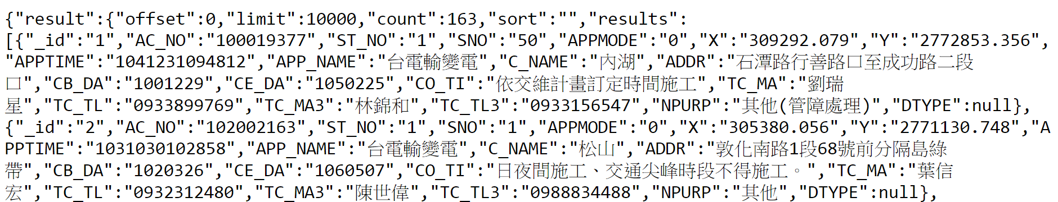
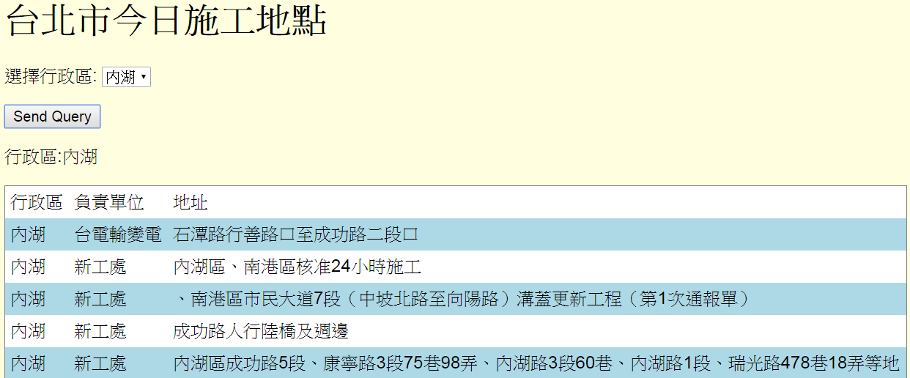
Exercise
Hint : data->result->results

Slide 65
Q&A

